Slide 1
Geospatial Information Systems
Professor Adam Dennett
Professor of Urban Analytics
Head of Department, CASA

Slide 2
Outline
Recap on last week
What is a GIS?
Brief history and state of the art
Managing geographic information
R as a GIS

Slide 3
Recap
What you should have learned last week:
How we can store spatial information on a computer, e.g. shapefile, csv, geojson, GeoPackage
Some of the common issues we may encounter when downloading and trying to analyse some ‘wild’ data
How do display some basic spatial data and draw a basic map using QGIS and R
How to store and save spatial data on your computer
Where you might be able to find spatial data on the web

Slide 4
This Week - What is a GIS?
We need to separate Geographic Information / Spatial Data SCIENCE from the tools we use to carry it out
GI / SD Science is facilitated by the information systems (technologies – hardware, software + human interaction) we use to:
Store (input)
Manipulate / Process
Distribute
Analyse
Retrieve (output)
Data / Information

Slide 5
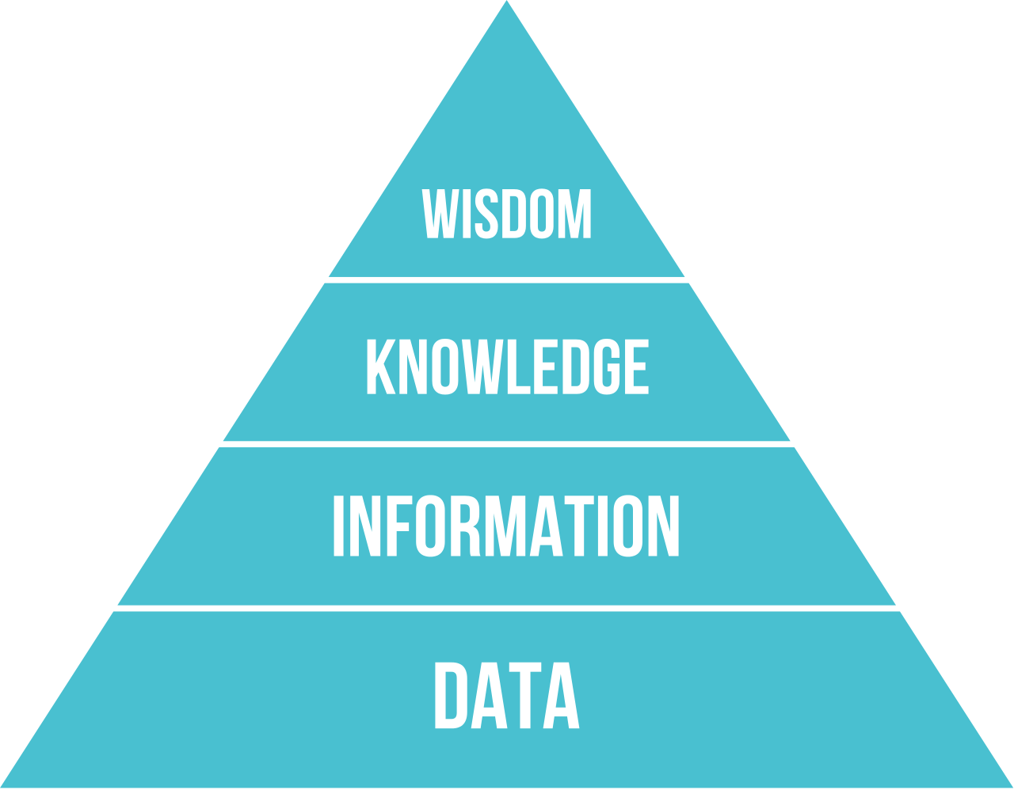
Data vs Information
Wider implications – Congestion is too high along major roads in city -> implement a new congestion charging policy to reduce traffic volumes
Context – the speed limit for major roads is 60kph. Congestion? Driver not fined for speeding?
Meaning and meta-data conferring additional info – e.g. 32 kph, red = major road
Raw numbers, lacks organisation – e.g. 32, ‘red’, etc.

Slide 6
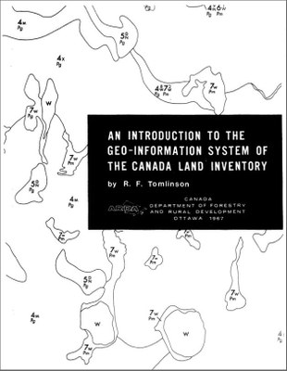

History of GIS
Invented/developed here at UCL!!
Roger Tomlinson – completed his PhD in UCL Geography in 1970s
Credited with developing the Canada Geographical Information System (CGIS), the first computerised “geographical information system” in the world in 1960s.
https://www.geog.ucl.ac.uk/news-events/news/news-archive/2014/february-2014/roger-tomlinson-1933-2014

Slide 7
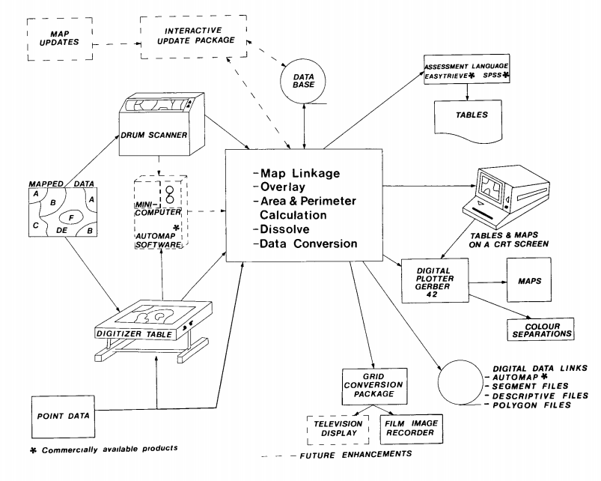
The Canada Geographical Information System
Storage
Display /Output
Data Capture / Input
Query /Processing / manipulation / analysis
https://cartogis.org/docs/proceedings/archive/auto-carto-4-vol-1/pdf/an-overview-of-the-canada-geographic-information-system(cgis).pdf

Slide 8


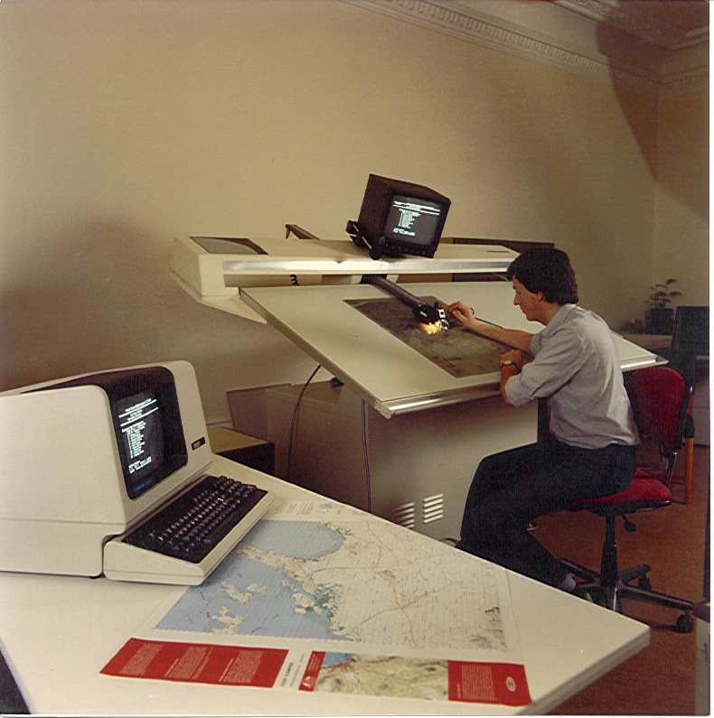



Data Capture / Input
Now
Then

Slide 9


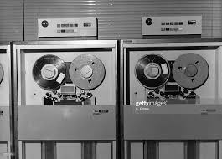



Data Storage
Now
Then
GEOJSON
http://switchfromshapefile.org/

Slide 10


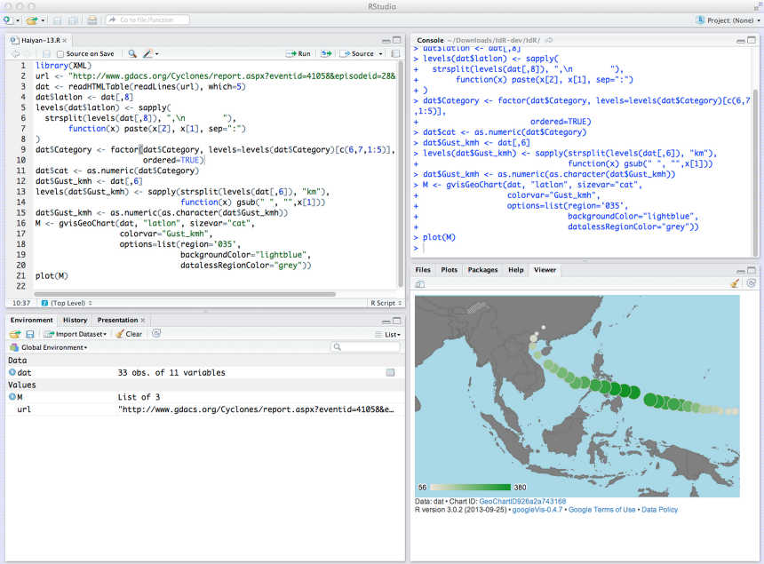
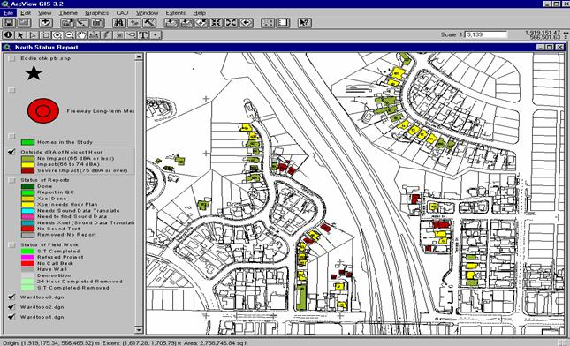
Query /Processing / Manipulation / Analysis
Now
Then

Slide 11
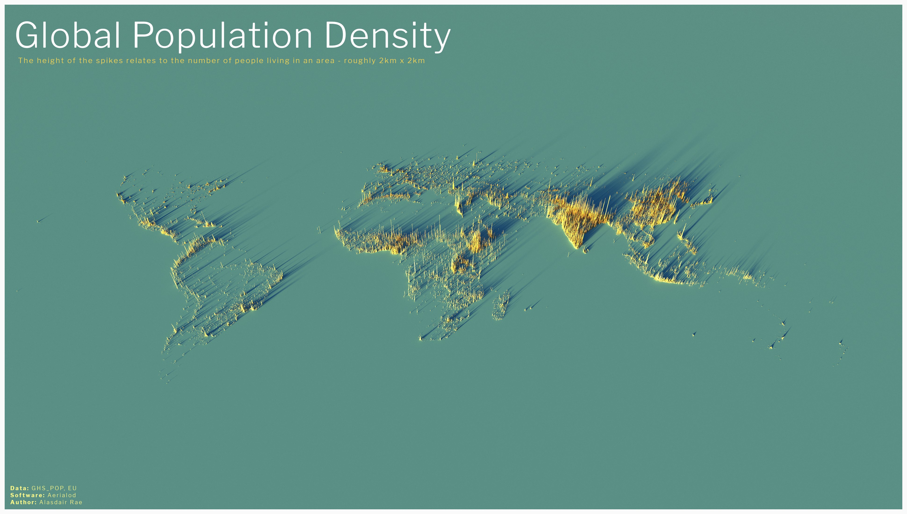
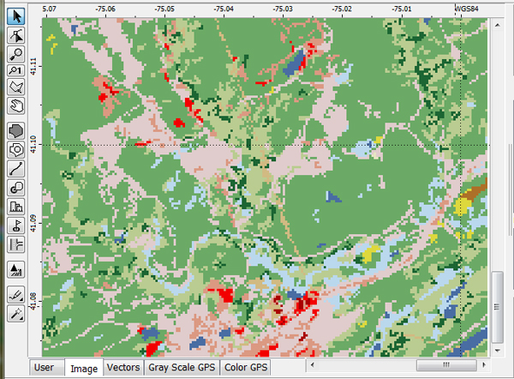
Data Output
Now
Then
https://twitter.com/undertheraedar/status/1259086700225146881/photo/1

Slide 12
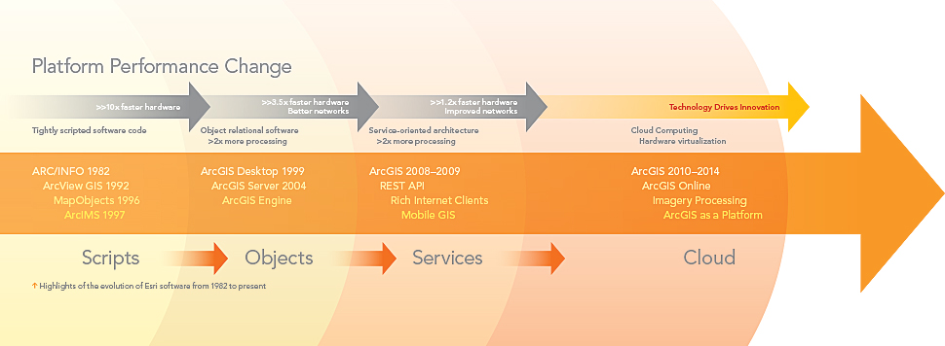

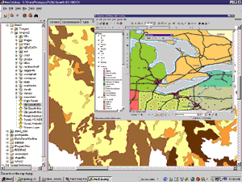

Evolution of commercial GIS products
From 1982, ESRI cornered the GIS market in terms of data storage, tools for Query /Processing / Manipulation / Analysis and Display / Visualisation
The Graphical User Interface – GUI – allowed non-specialists to carry out GI Science for the first time

Slide 13

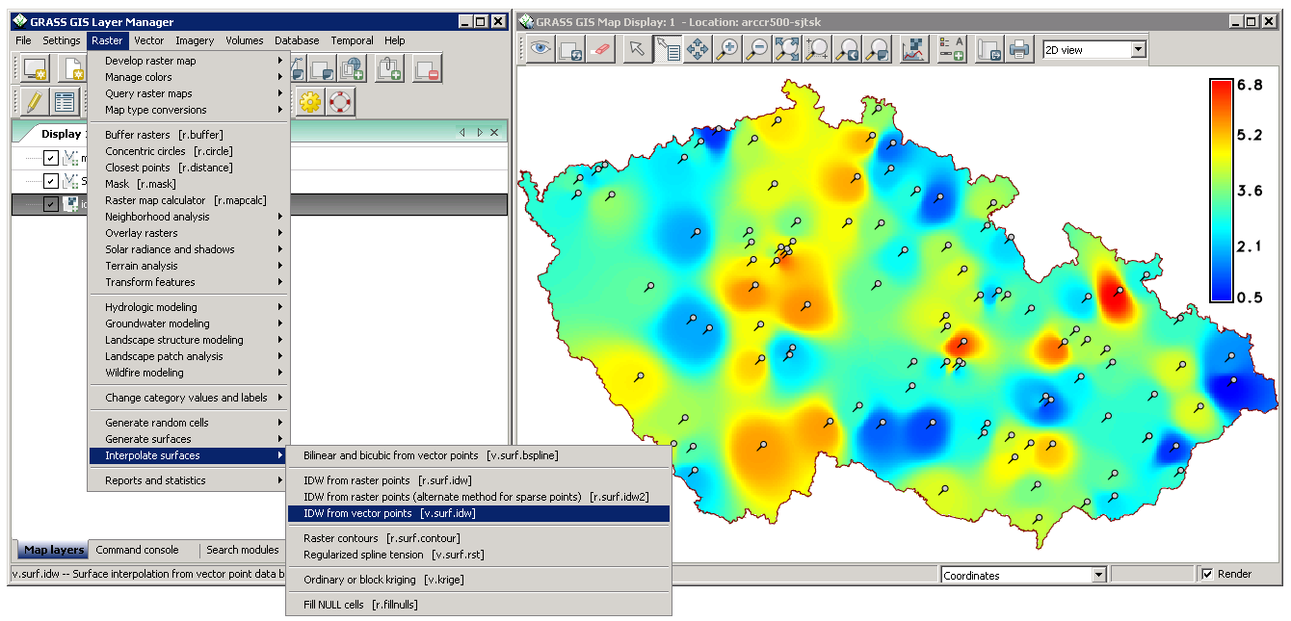
GUI Alternatives to Arc - GRASS
Under continual development since 1982
Free and Open Source
Functions can be called from QGIS
Not as fully functioned and slick as Arc
https://grass.osgeo.org/

Slide 14

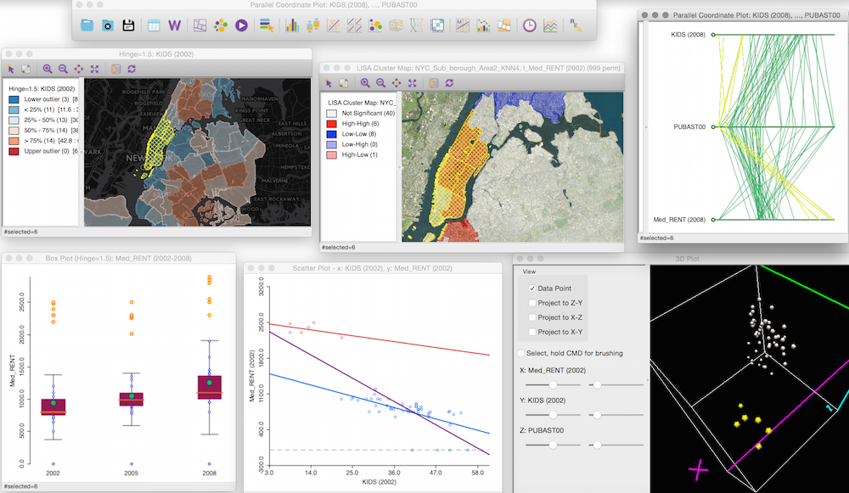
GUI Alternatives to Arc - GeoDa
Developed at the University of Chicago since 2003
Particularly good for spatial modelling and visualisation
Free
Many functions also in pysal python library

Slide 15

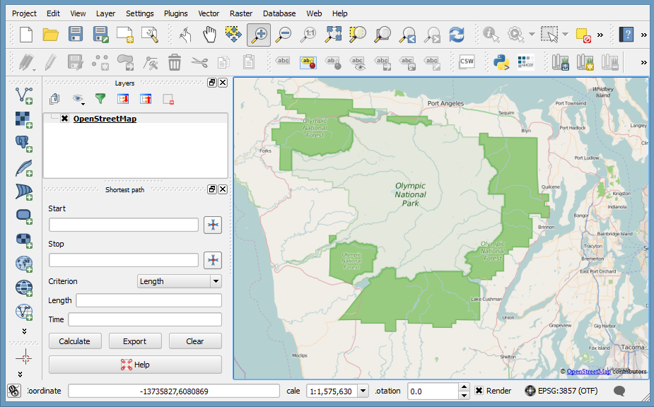
GUI Alternatives to Arc - QGIS
Under development since 2002
Free & Open Source – everything is on github!
Probably best GUI GIS aside from Arc
Connects to PostGIS database very effectively
Slick maps with nice default features
Large library of plugins for analysis
https://www.qgis.org/en/site/
https://github.com/qgis/QGIS

Slide 16
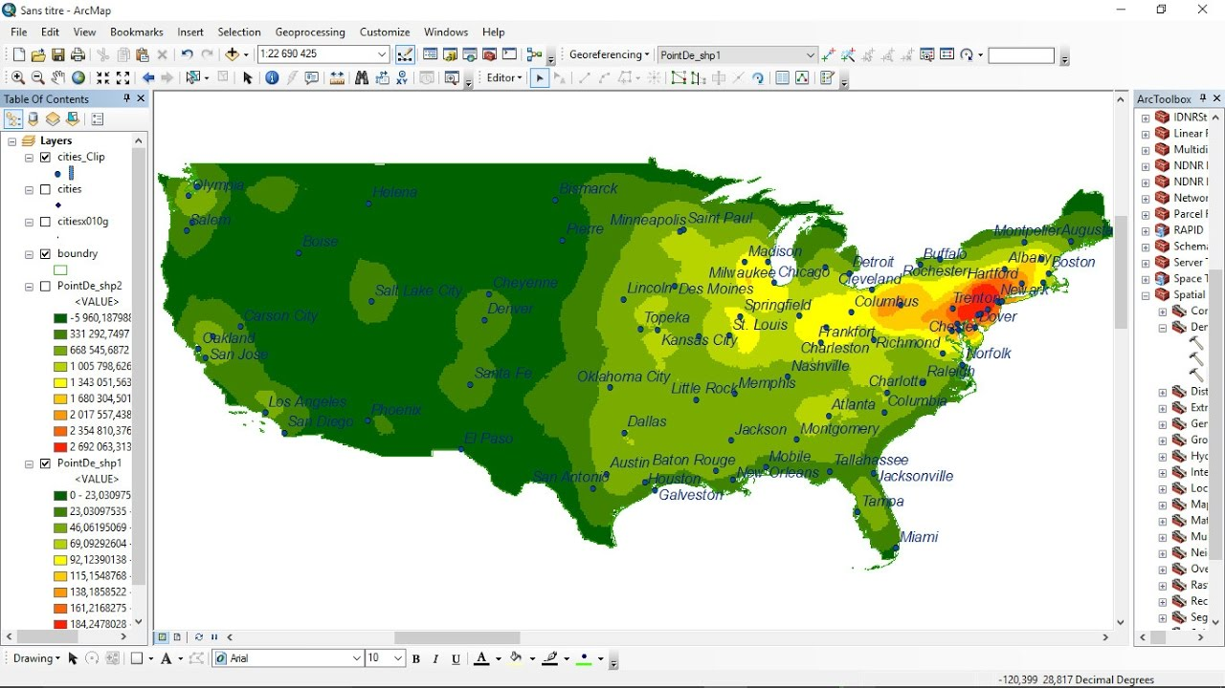
Why is Arc so successful?
Graphical User Interface – GUI
Continual Development
User Support
Big suite of analysis functions / cartographic options + model builder for automation of these processes
Educational licences
The shapefile
BUT
Expensive
Big
Buggy

Slide 17

Managing Geographic Information – the shapefile
Become the de facto spatial data format for storing and sharing (latterly, online) vector data
Collection of files –
.shp - Geometries
.shx - Index
.dbf – Attributes
+ some others!
https://twitter.com/shapefiIe

Slide 18

shapefiles
The Bad
No coordinate reference system definition.
It's a multifile format.
Attribute names are limited to 10 characters.
Only 255 attributes. The DBF file does not allow you to store more then 255 attribute fields.
Limited data types. Data types are limited to float, integer, date and text with a maximum 254 characters.
Unknown character set. There is no way to specify the character set used in the database.
It's limited to 2GB of file size. Although some tools are able to surpass this limit, they can never exceed 4GB of data.
No topology in the data. There is no way to describe topological relations in the format.
Single geometry type per file. There is no way to save mixed geometry features.
More complicated data structures are impossible to save. It's a "flat table" format.
There is no way to store 3D data with textures or appearances such as material definitions. There is also no way to store solids or parametric objects.
Projections definition. They are incompatible or missing.
Line and polygon geometry type, single or multipart, cannot be reliably determined at the layer level, it must be determined at the individual feature level.
The Good
Shapefile is by far the most widely supported format in existing software packages.
While the format is proprietary, the specification is open.
For many use cases, it is good enough.
Index files (e.g. *.shx) enable good reading performance.
It is relatively efficient in terms of file size. The resulting file, even un-zipped, is relatively small compared to some other (mostly text-based) formats.
From - http://switchfromshapefile.org/

Slide 19
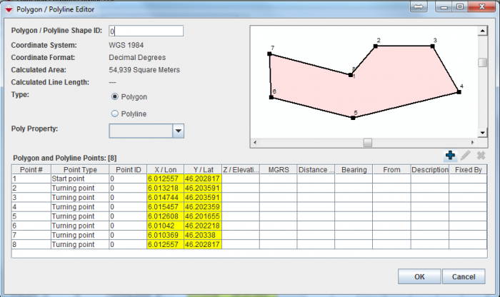
Managing Geographic Information
All vector data formats are essentially the same and comprised of two main elements:
Geometries - storing coordinates for either points, lines or polygons
Attributes – storing some other information about the geometries

Slide 20
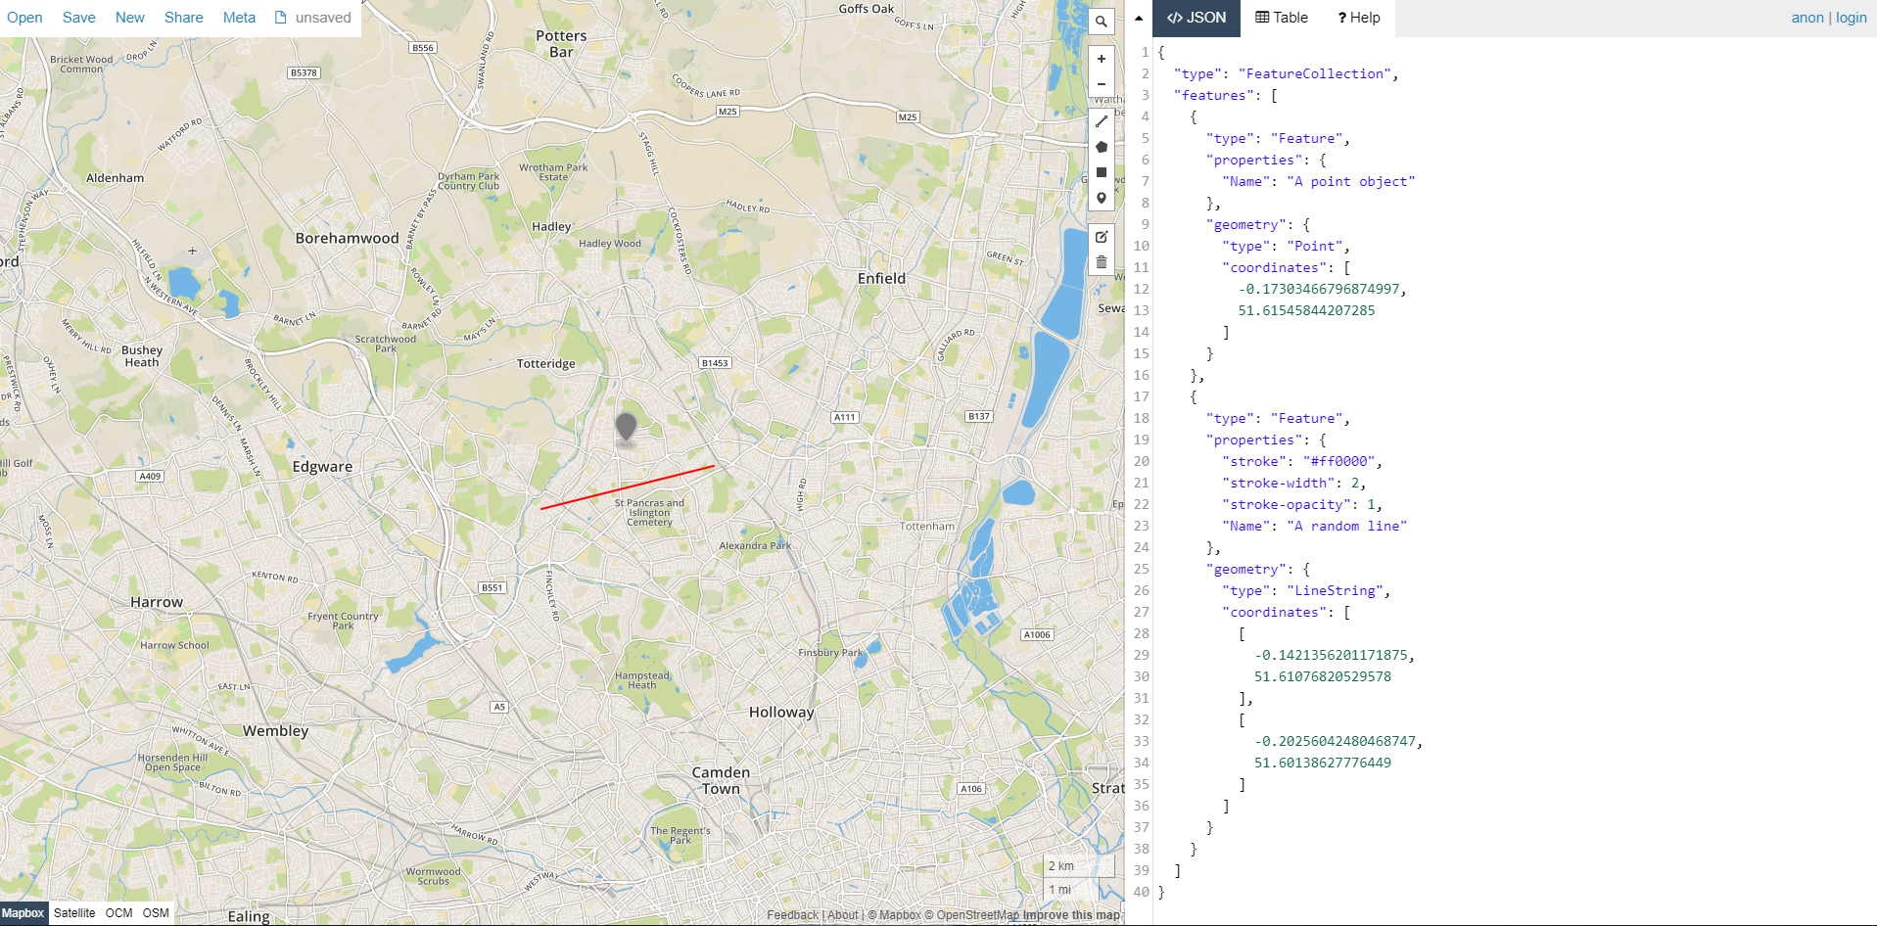
Managing Geographic Information – Alternatives to .shp
GeoJSON (mark-up similar to XML)
Simple – particularly good for web applications
Doesn’t support every data type – e.g. dates
http://geojson.io/
Could different file formats be developed that follow the same sort of rules for storage?

Slide 21

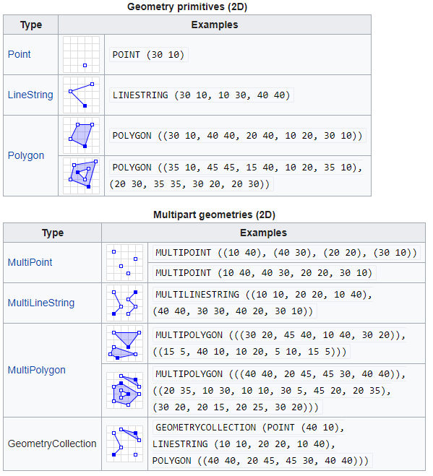
Managing Geographic Information - Standards
The Open Geospatial Consortium
Governing standards around spatial data since 1992
Defined the ‘well-known-text’ (WKT) format for representing vector geometries

Slide 22
Managing Geographic Information – Simple Features
Simple Features - OGC standard that specifies a common storage and access model for 2D geometries
2 part standard:
Part 1 – Common Architecture defining geometries, attributes etc. via WKT
Part 2 - supports storage, retrieval, query and update of simple geospatial feature collections via SQL (structured query language – been around since the 1970s)
Simple Features implemented in:
The sf^{[1]} package - R
MySQL Spatial Extensions.^{[2]}
PostGIS extension for PostgreSQL
SpatiaLite extension for SQLite^{[3]}
Oracle Spatial
Microsoft SQL Server since version 2008,^{[4]} with significant additions in the 2012 version.[

Slide 23
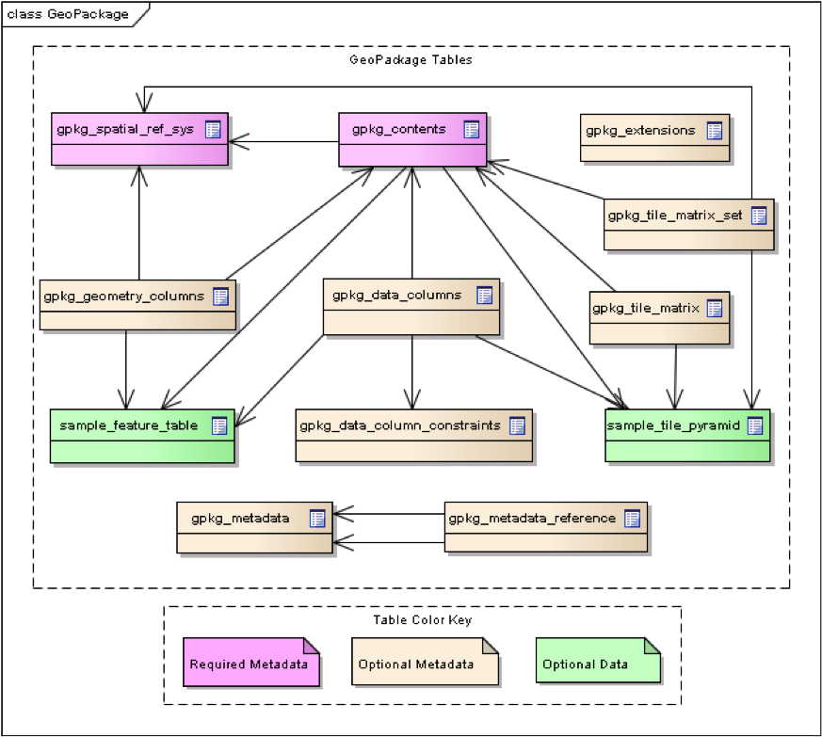
Managing Geographic Information – GeoPackage
GeoPackage - SQLite Database file/container - .gpkg
The SQLite - open source and multi-platform
SQLite stores data in a single file (so no need to zip/unzip)
WKT Geometry stored in single geometry field in the database
https://www.geopackage.org/

Slide 24
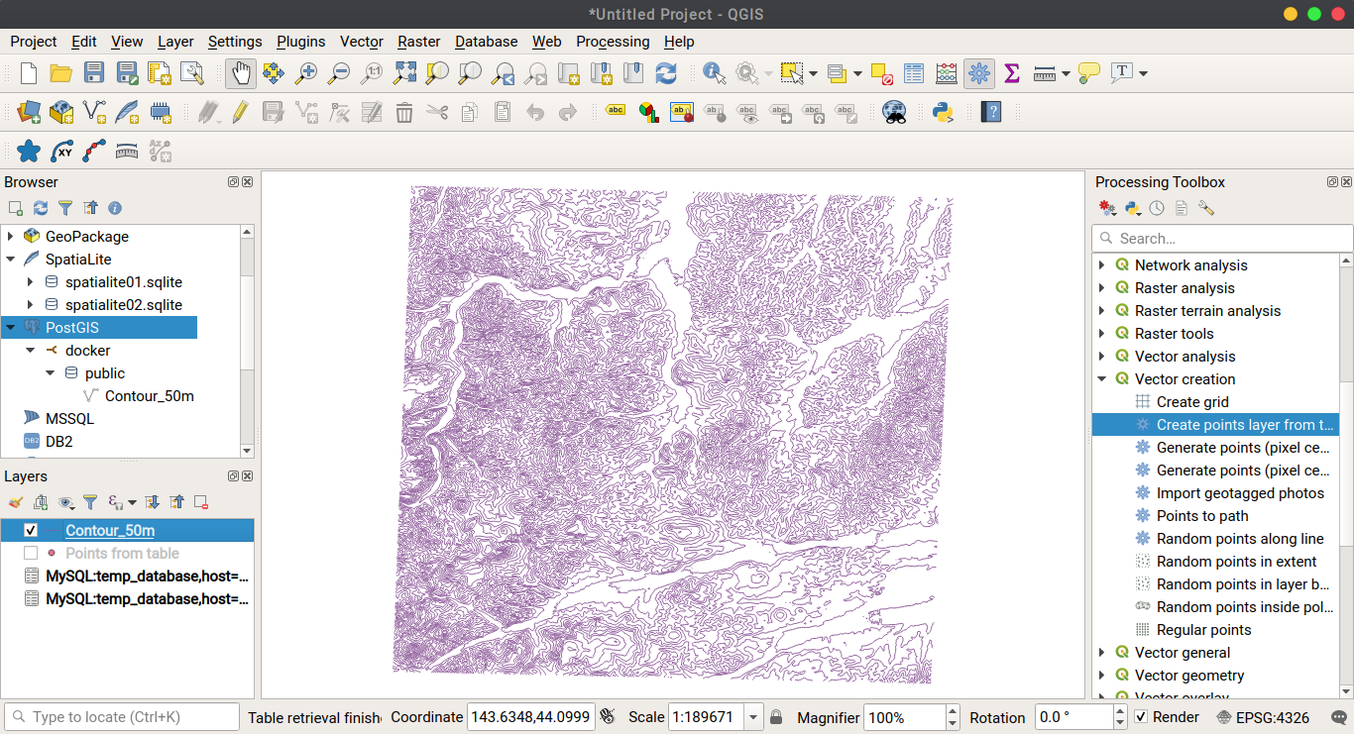
Managing Geographic Information – PostGIS
Spatial extension to the PostgreSQL object-relational database
Free and Open Source
Powers some of the world’s most famous platforms (Facebook, Instagram, OpenStreetMap etc.)
Perfect if you want to do some serious heavy-lifting big-data processing & spatial queries
Connects to QGIS & R very nicely
Difficult to master!

Slide 25

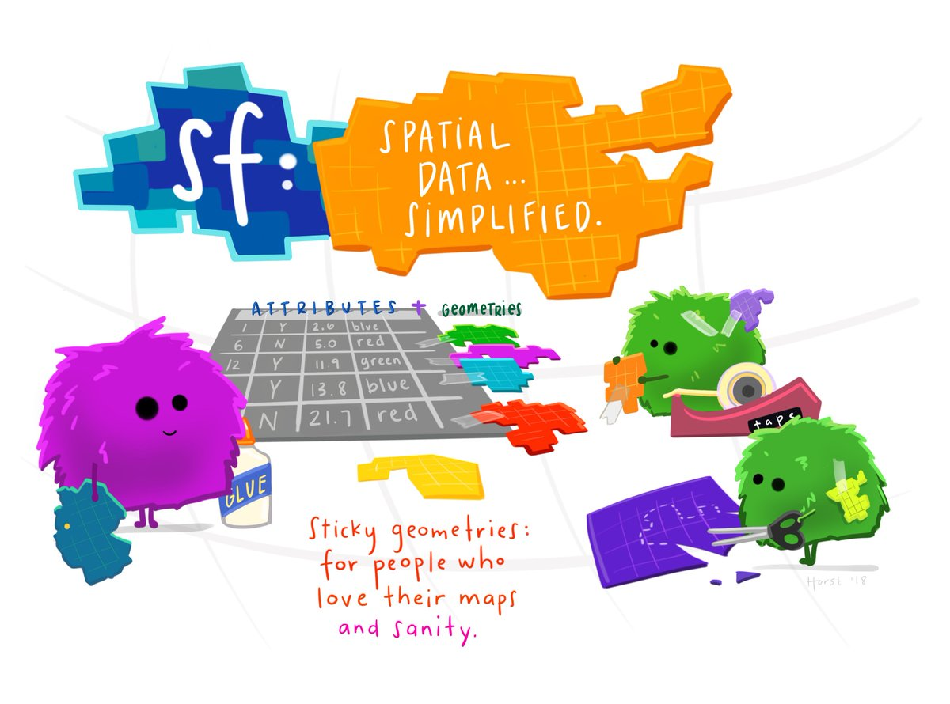
Managing Geographic Information – sf
The Simple Features (sf) package facilitates the storage, access and management of geometric objects stored as simple features, in R
sf arrived in around 2018
Replaced previous sp (2003) package
https://r-spatial.github.io/sf/index.html

Slide 26
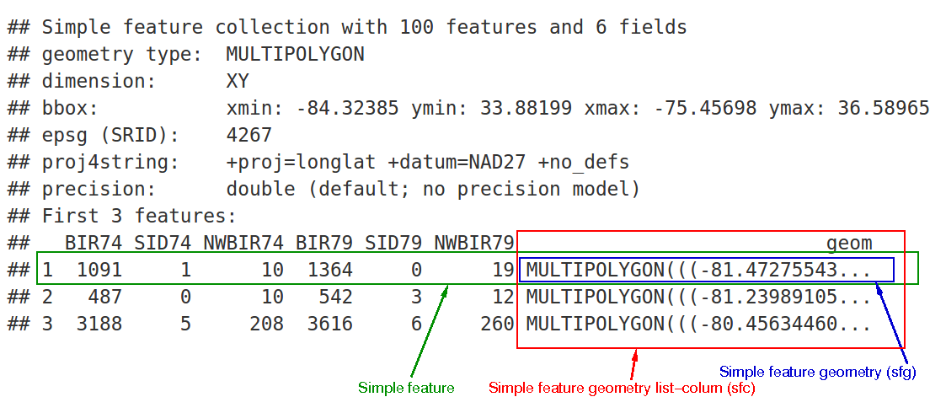
sf
sf objects are data tables (knows as Data Frames in R) with a geometry column containing WKT geometries at the end
sf package contains a sample dataset (ironically read from a bundled shapfile!!)
https://r-spatial.github.io/sf/articles/sf1.html

Slide 27
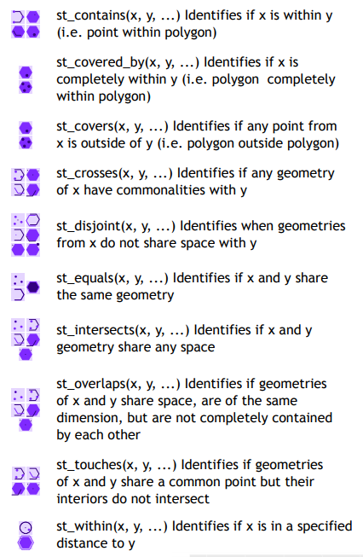
sf
Contains a huge set of tools for
reading and writing spatial data – from shapefiles or other formats
querying a range of different point, line and polygon vector geometries
st_ prefix for all functions identical to that used in postgis spatial SQL queries
https://github.com/rstudio/cheatsheets/blob/master/sf.pdf

Slide 28
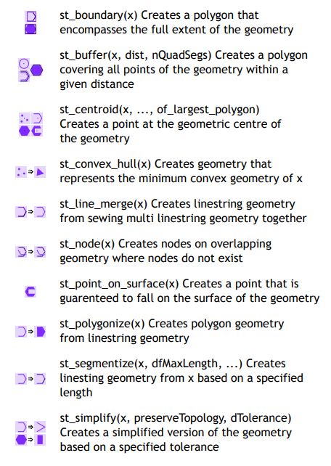
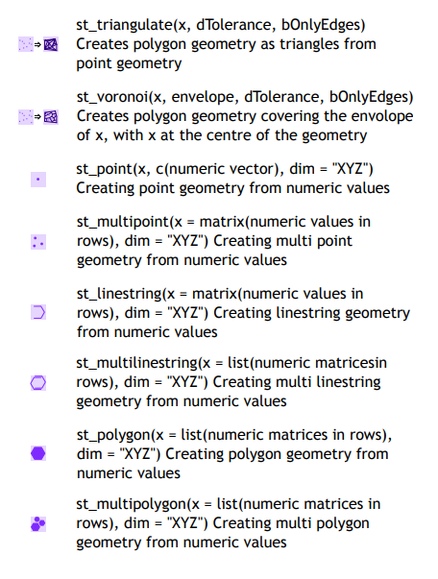
sf
Can carry out a vast range of geometric operations

Slide 29
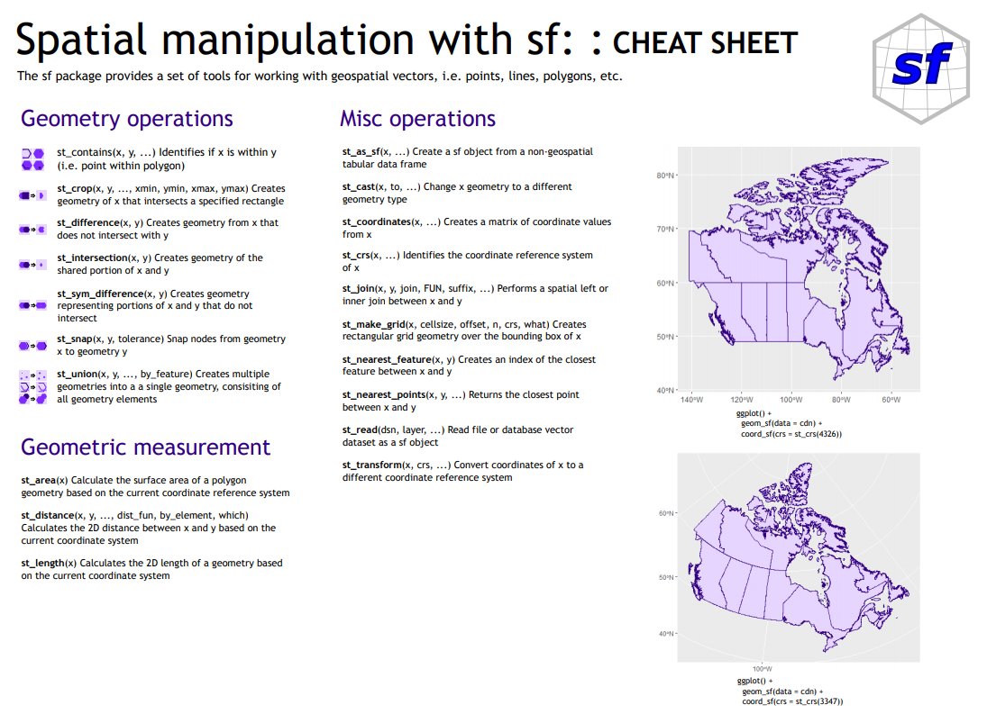
sf

Slide 30

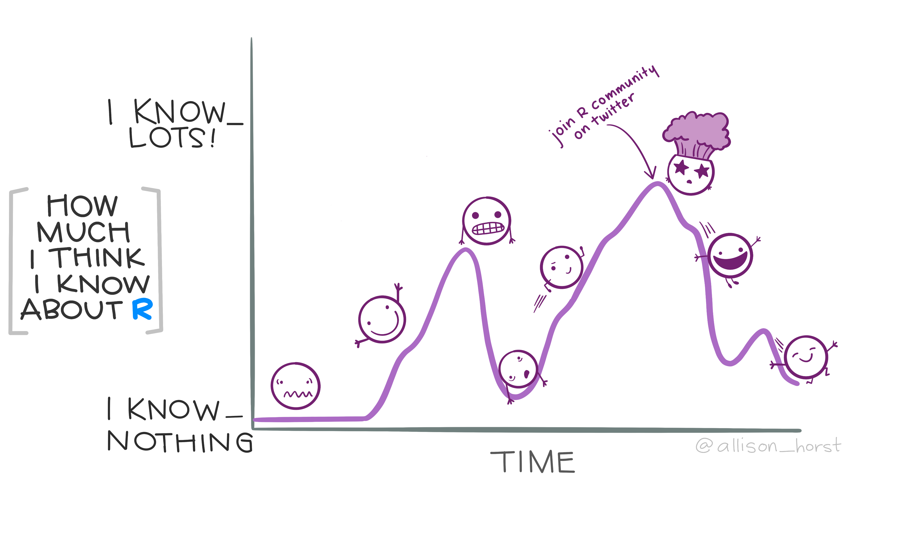
R as a GIS
https://www.r-project.org
“R is a language and environment for statistical computing and graphics.”
“R is an integrated suite of software facilities for data manipulation, calculation and graphical display”

Slide 31
R as a GIS
Storage
Graphical Display
Manipulation & Calculation

Slide 32





R as a GIS – data management
Data management/ storage facilitated through connection to a range of file formats (almost any you can think of)
Plus a huge host of software packages for reading, writing and converting data held within these files into a format R can handle

Slide 33




R as a GIS – packages for reading/writing data
The readr package makes it easy to read (clean) and write tabular data into tibbles (more of which shortly)
The sf package takes advantage of the Geospatial Data Abstraction Library (GDAL) to enable the reading and writing of spatial objects
rgdal – allows r to access GDAL
rpostgis allows easy reading and writing to postgis databases!
haven for SPSS, SAS, Stata
readxl
rpostgis
https://github.com/tidyverse/readr

Slide 34
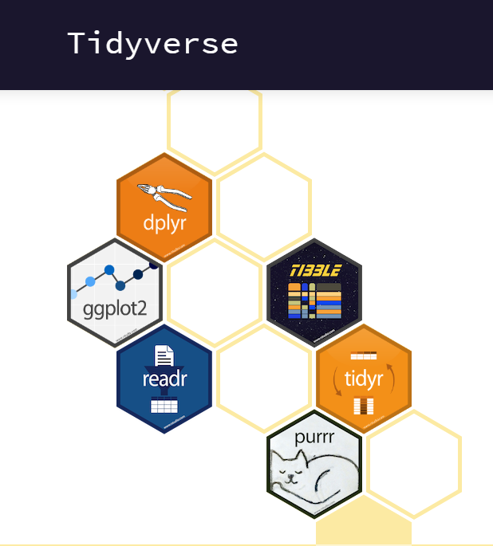
R as a GIS – data manipulation & processing
R has always had packages for manipulating, processing and visualising data
Packages are pieces of software designed for specific tasks within the R environment
Recently, some of the best have been brought together under the ‘tidyverse’ banner
“The tidyverse is an opinionated collection of R packages designed for data science. All packages share an underlying design philosophy, grammar, and data structures.”
Tidyverse packages cover much of the data manipulation, processing and visualisation capabilities required of a GIS
https://www.tidyverse.org

Slide 35

Tidyverse philosophies – Tidy Data
each type of observational unit forms
a table
https://tidyr.tidyverse.org/articles/tidy-data.html

Slide 36
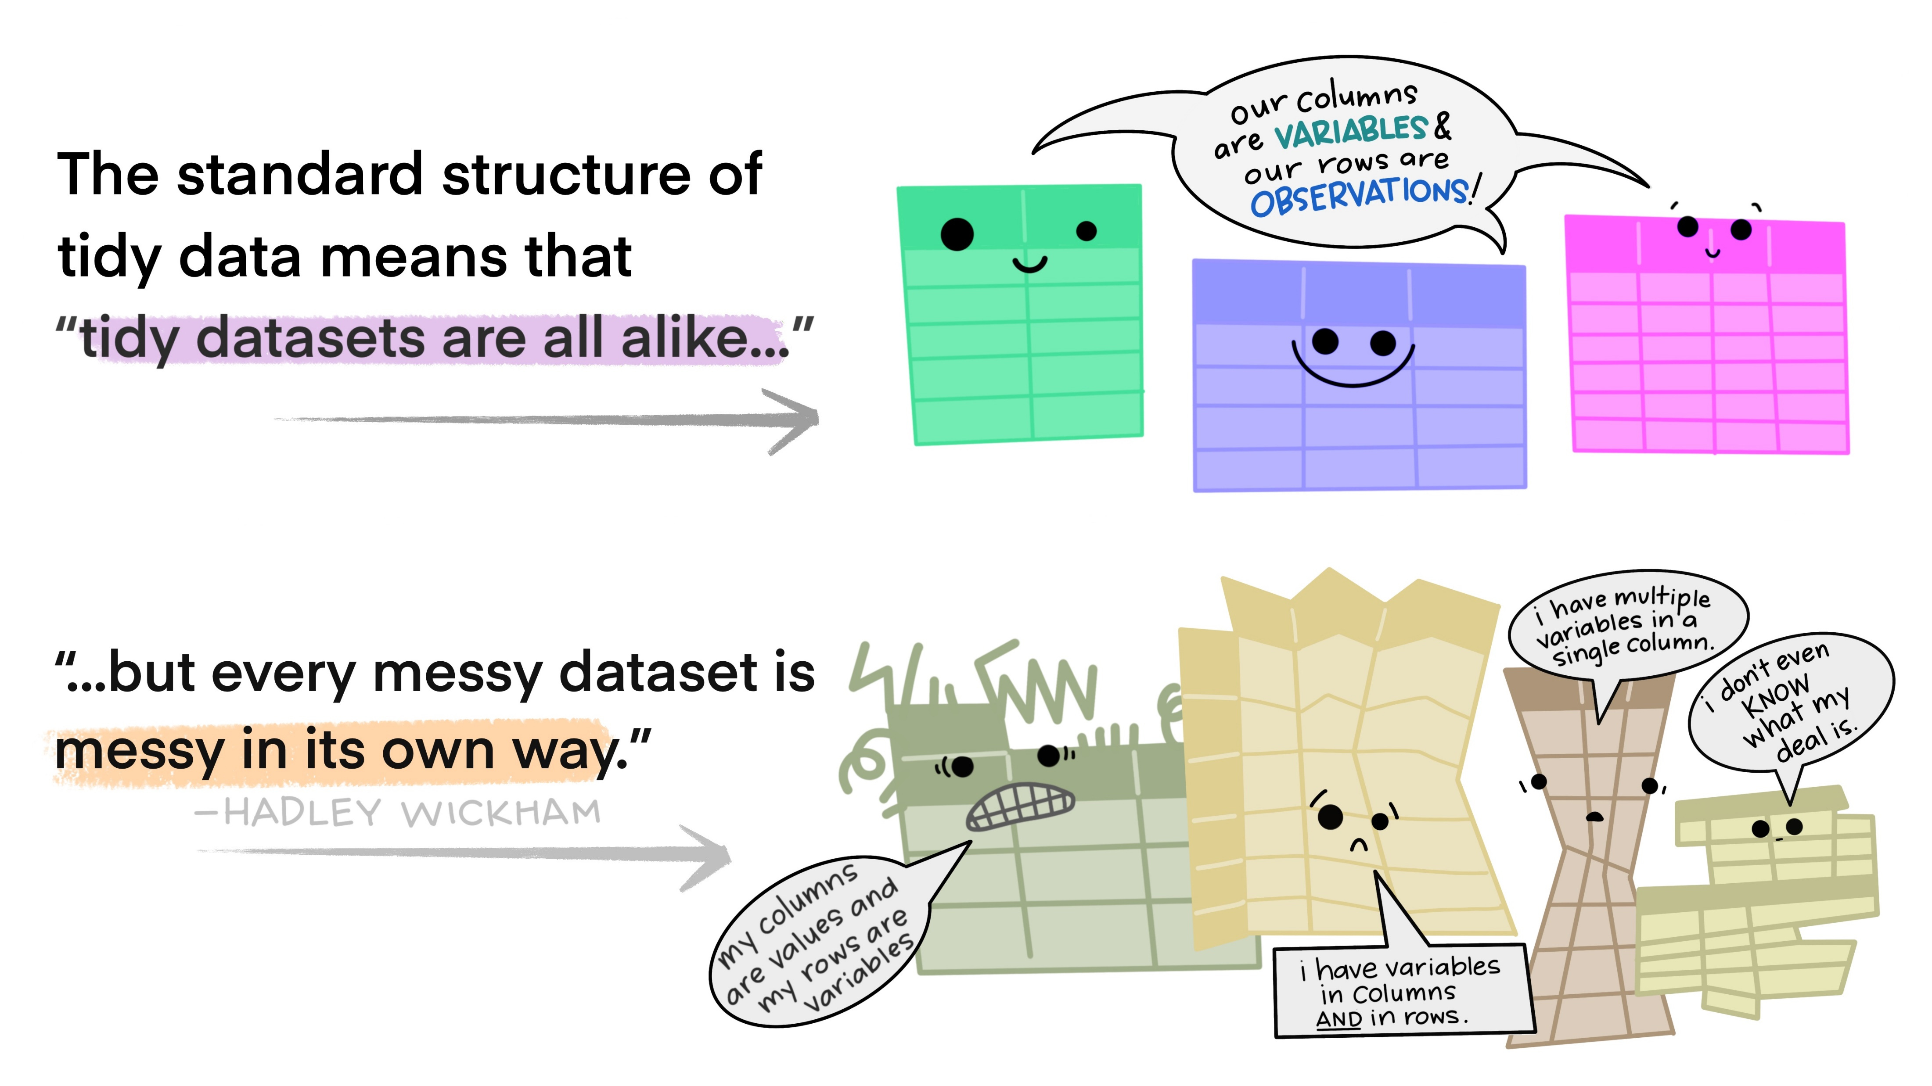
Tidy Data & Messy Data
https://github.com/allisonhorst/stats-illustrations

Slide 37
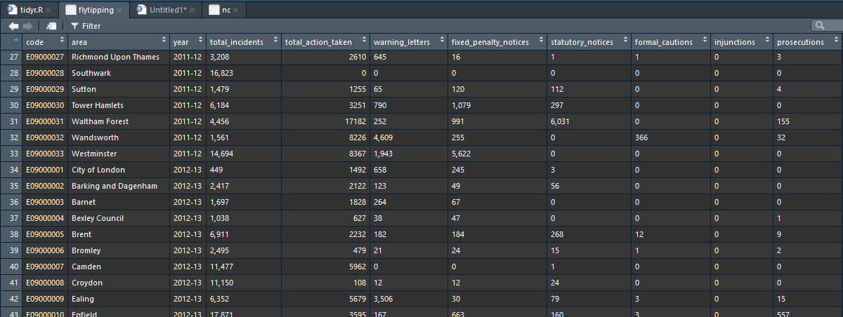
Tidy Data?
Each variable forms a column – “A variable contains all values that measure the same underlying attribute (like height, temperature, duration) across units.”
Each observation forms a row – “An observation contains all values measured on the same unit (like a person, or a day, or a race) across attributes.”
Each cell is a single measurement.
Each type of observational unit forms a table.
https://tidyr.tidyverse.org/articles/tidy-data.html

Slide 38
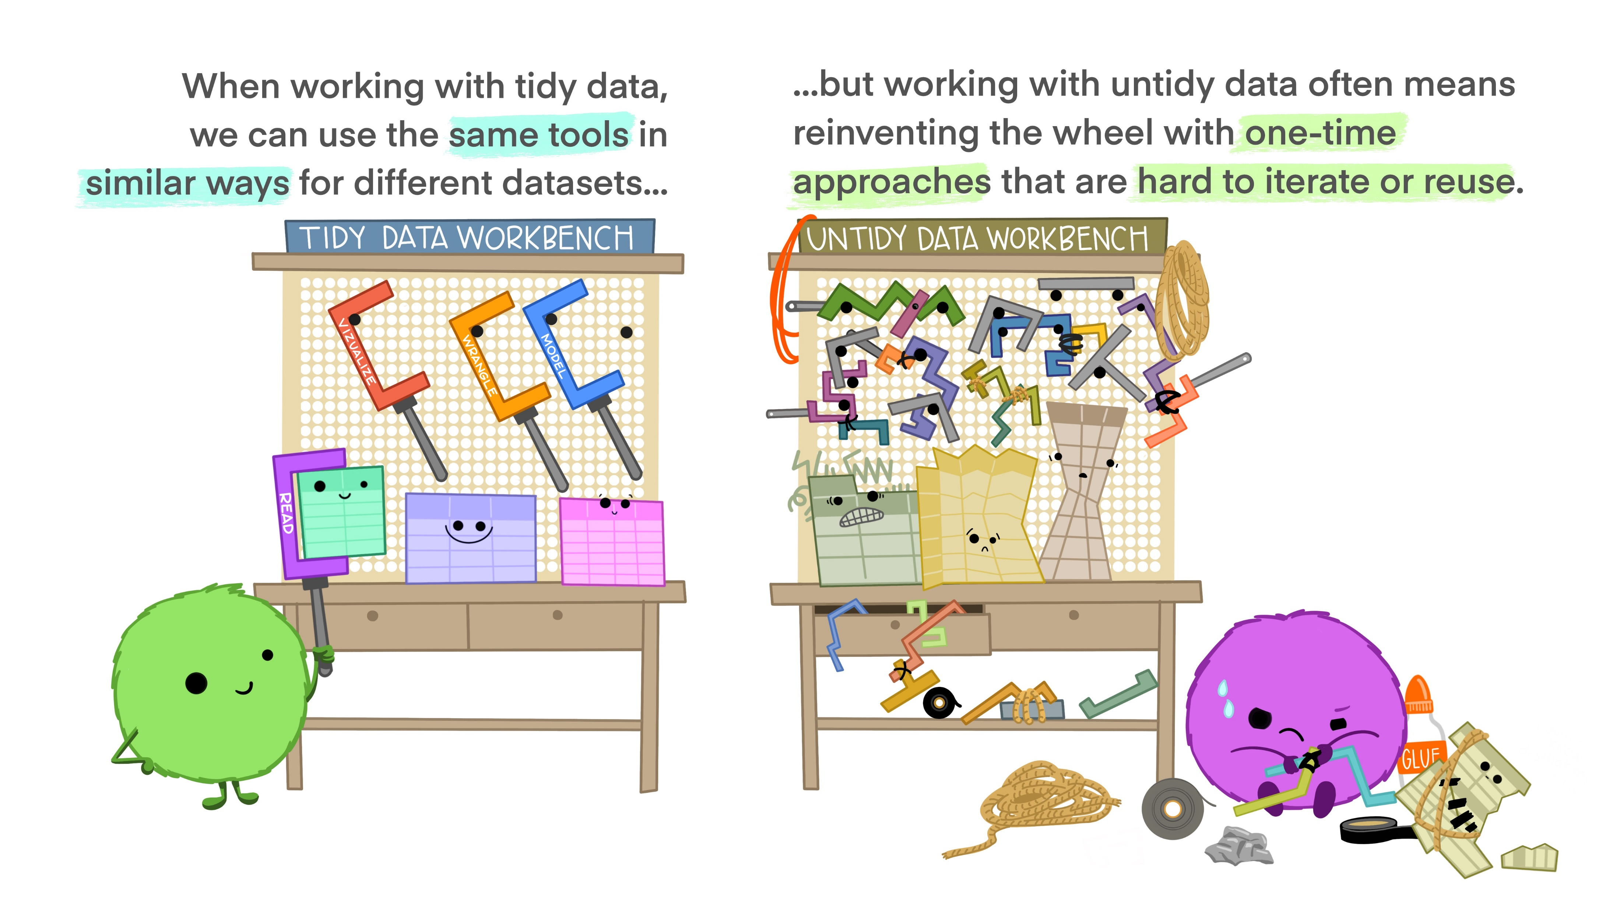
Why Tidy Data?
https://github.com/allisonhorst/stats-illustrations

Slide 39

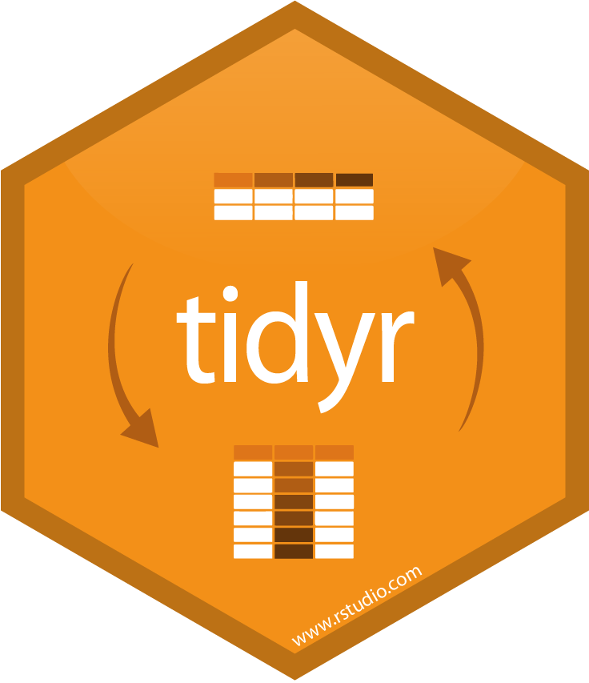



Tidy Data Tools
Data can be made tidy in R using packages for re-arranging and cleaning such as tidyr and dplyr
Once tidy, data can be reshaped (aggregated, split etc.) for whatever purposes you wish
NOTE – the tidy format might not the be the most useful for mapping or visualising, but it is the best for flexibility
Tidy data stored in a tibble – which is fussy table and forces you to not make silly errors
Other packages like stringr and forcats allow you to fix issues with stings (text) or categorical variables

Slide 40
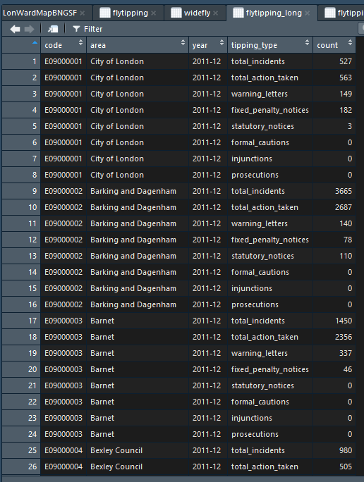
Tidy Data?
Each variable forms a column.
Each observation forms a row.
Each type of observational unit forms a table.

Slide 41
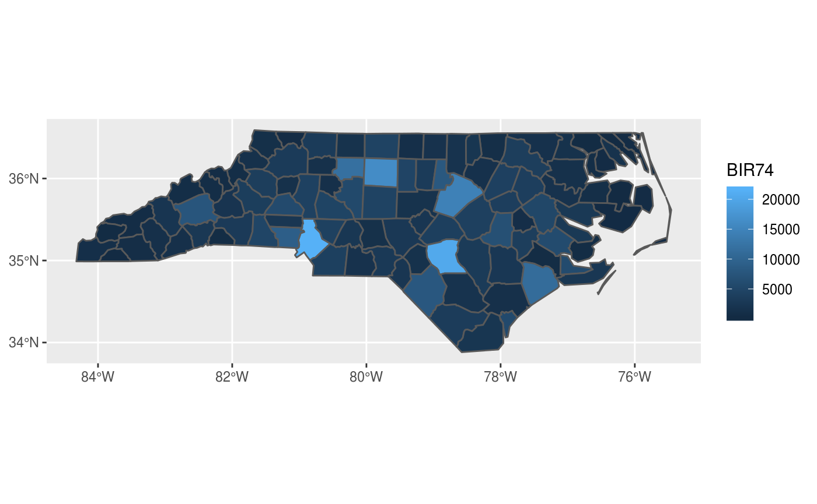
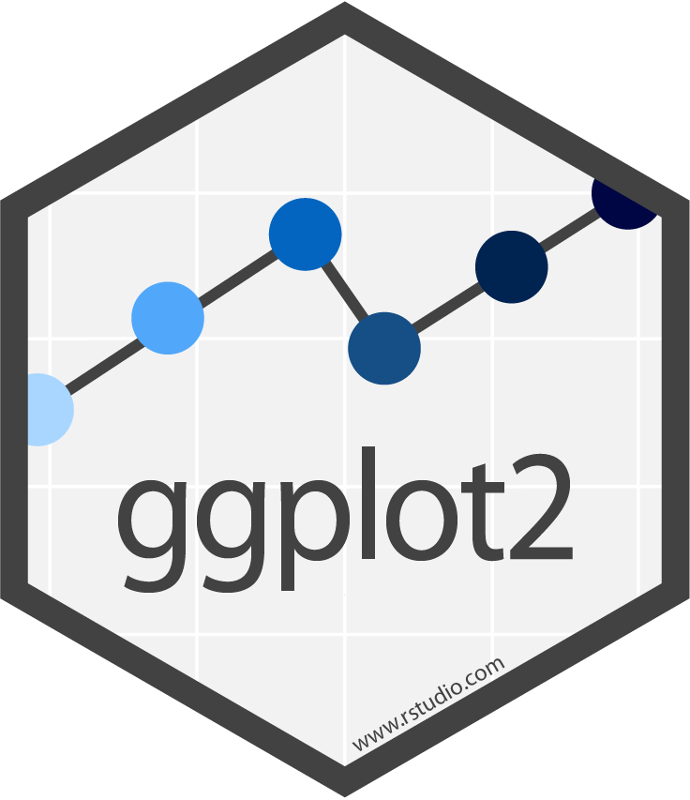
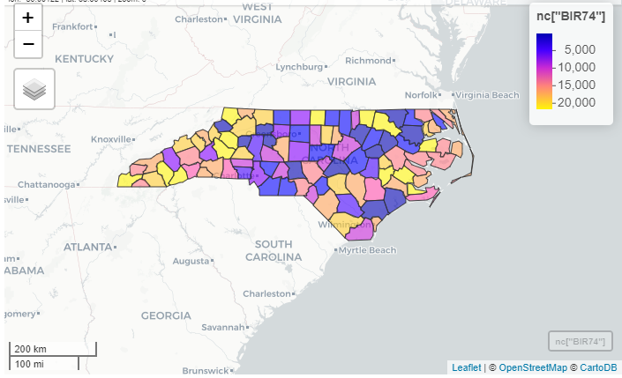
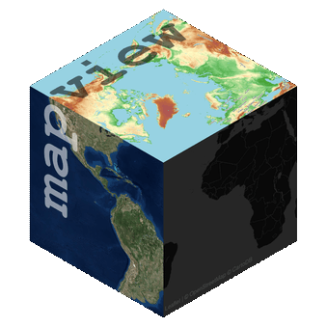
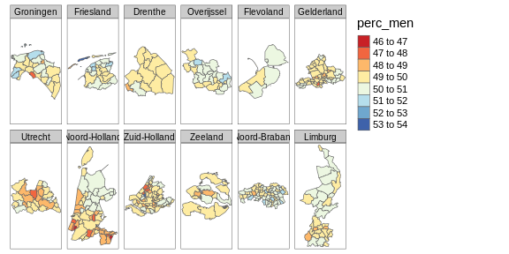

R as a GIS – data visualisation, display and output
R has a variety of packages that facilitate visualisation of geometric data
Packages like ggplot2 and tmap follow the Layered Grammar of Graphics principles espoused in the tidyverse
tmap
https://r-spatial.github.io/sf/articles/sf5.html

Slide 42
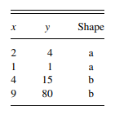
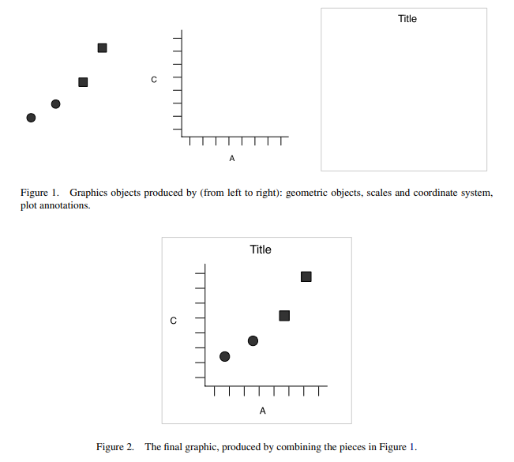
Tidyverse philosophies – The Grammar of Graphics
Basic idea is that graphics can be built up through multiple layers of data
Values in a dataset are examples of ‘aesthetics’ – values that can be viewed in a graphic
Data, scales and coordinate systems and plot annotations can then be layered to produce the graphic
Hadley Wickham (2010) A Layered Grammar of Graphics, Journal of Computational and Graphical Statistics, 19:1, 3-28, DOI: 10.1198/jcgs.2009.07098

Slide 43
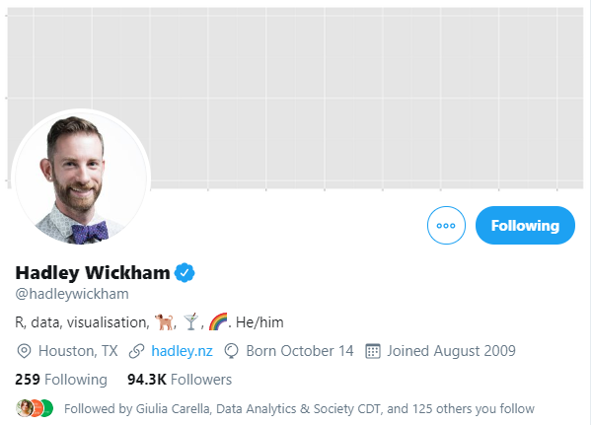
The Layered Grammar of Graphics
ggplot (gg = grammar of graphics), developed by Hadley Wickham, changed the game with data visualisation in R
geom_sf – recent addition and provides a graphical object that allows for easy display of simple features objects (BOOM!)
Interactive via ggplotly

Slide 44

R as a GIS – Spatial Analysis
R has a huge list of packages for carrying out a massive range of different spatial analysis tasks
Roger Bivand – responsible for lots of early work in R spatial universe, maintains a very useful website of packages
We will learn about some of these later in the course…
https://cran.r-project.org/web/views/Spatial.html

Slide 45


R as a GIS – Dissemination and Sharing
R Markdown allows you to document the full end-to-end process of reading, cleaning, analysing, visualising and the publishing research
From the same code, HTML web pages, PDF documents, word documents, LaTeX documents, dashboards and presentations can all be created.
Shiny allows fully-fledged interactive web-applications to be created.

Slide 46
Why use R as a GIS?
Seamless integration of data
Reading / writing
Cleaning
Manipulating
Analysis
Visualisation
Documentation
Dissemination
Through integrating all of these, reproducible science is facilitated (more of which in future weeks)
It’s FREE!!
Constantly evolving
Has an almost endless collection of spatial analysis, statistics and visualisation packages which will cover all of your needs.

Slide 47
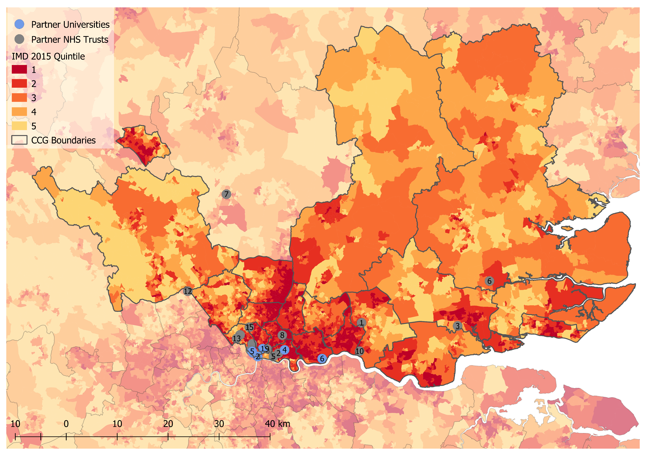
Why use anything else as a GIS? - Cartography
*Don’t tell anyone but… I probably create more maps using QGIS than R!*
For fine-tuning cartographic outputs for print, sometimes only a desktop GUI GIS will do – my current favourite is QGIS
Sometimes it’s just easier to click a few buttons!!

Slide 48
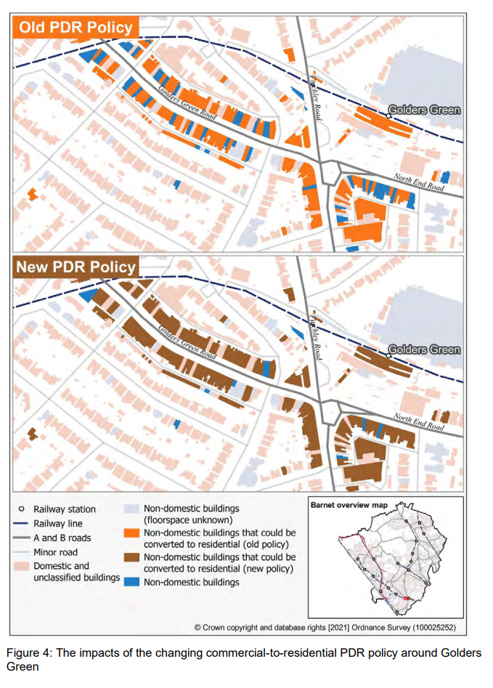
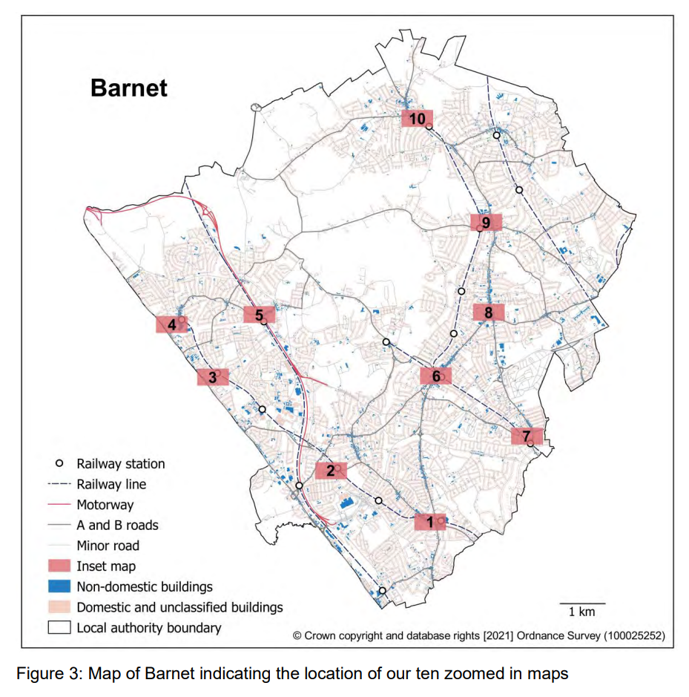
Why use anything else as a GIS? - Cartography
Report by Ben Clifford, Bin Chi and myself this summer on changes to permitted development rights – Bin created all maps in QGIS
QGIS allows for far more customisable cartographic outputs
https://www.tcpa.org.uk/2021-pdr-research

Slide 49
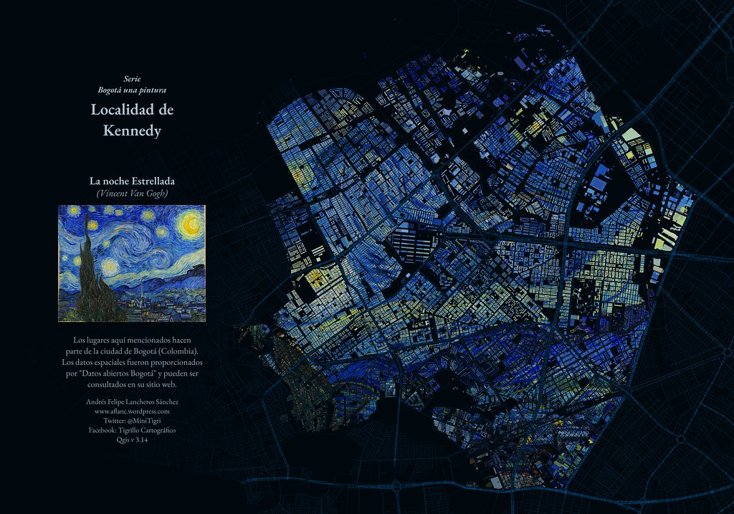
Why use anything else as a GIS? - Cartography

Slide 50
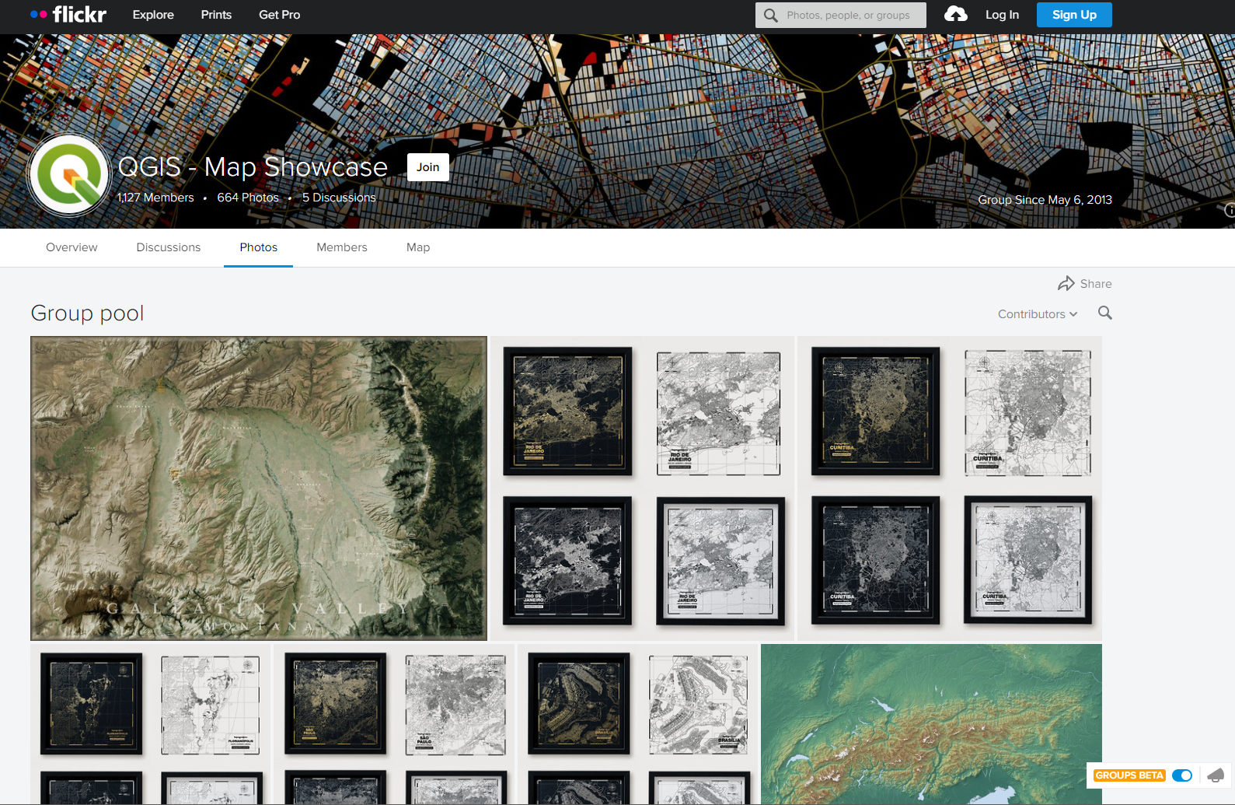
Why use anything else as a GIS? - Cartography
https://www.flickr.com/groups/2244553@N22/pool/with/50355460063/

Slide 51
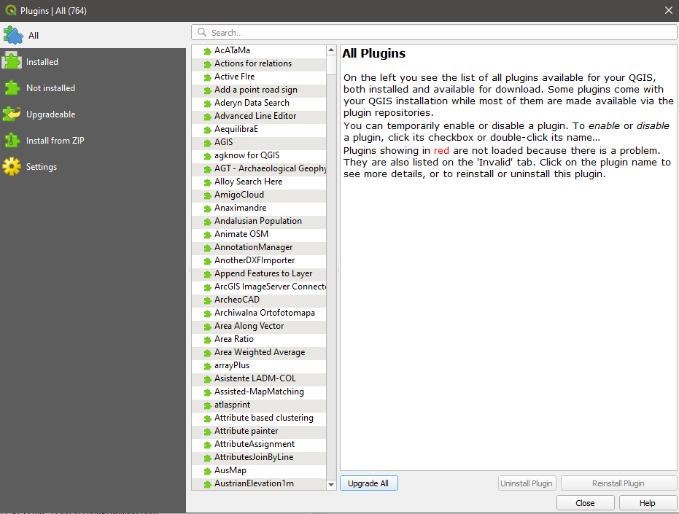
Why use anything else as a GIS? – Analysis Tools
QGIS has some sick plugins which allow you to do almost anything:
Route Planning
OSM data download (although can do this in R too)
Animations

Slide 52

Why use anything else as a GIS? – Heavy Lifting
+
=
+
=
For serious heavy lifting geo-processing tasks + visualisation, PostGIS + R or QGIS cannot be beaten – e.g. splitting every building polygon in London using cadastral land parcels!

Slide 53


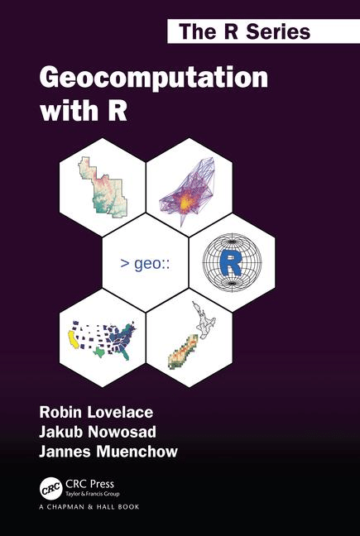
R as a GIS
Pretty much everything you need to know about using R as a GIS can be found here
https://r4ds.had.co.nz/
https://geocompr.robinlovelace.net/

Slide 54
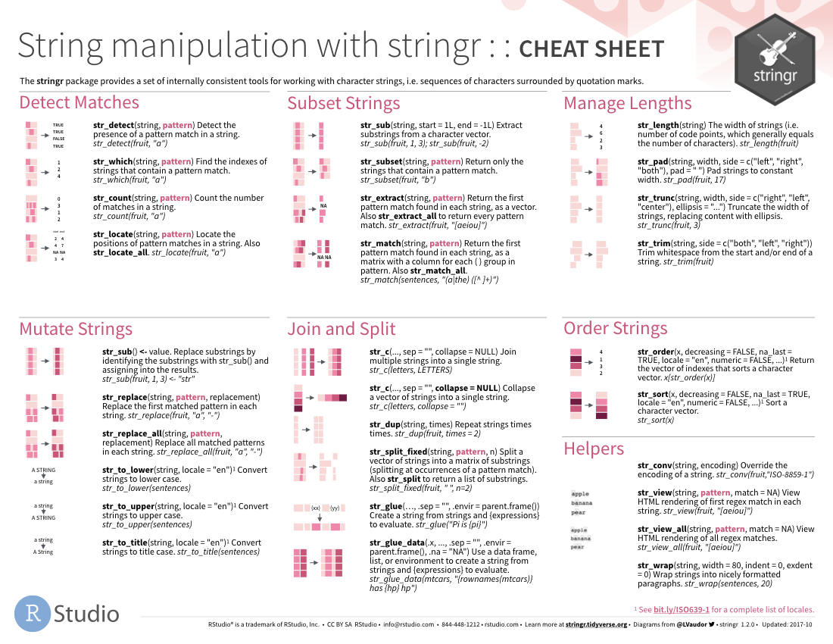
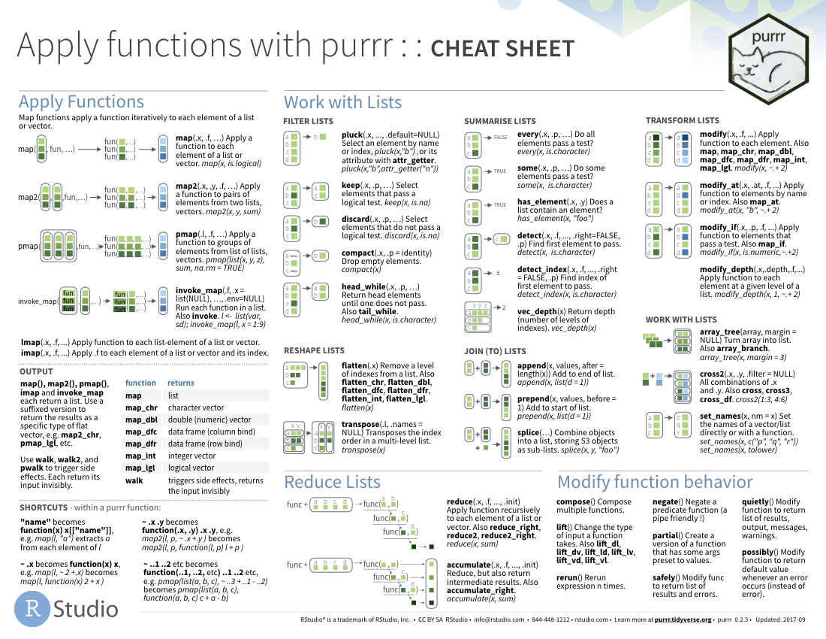

R Studio Cheatsheets
And virtually everything you will need to know about data manipulation and analysis will be found via the brilliant and growing selection of R Studio Cheatsheets
https://rstudio.com/resources/cheatsheets/

Slide 55
Conclusions
In many ways Geospatial / Geographic Information Systems have evolved considerably since their invention in the 1970s
However, at their core, they still carry out exactly the same functions of data input, storage, processing/manipulation, analysis and visualisation that they did 50 years ago
Software and data have evolved. Analysis has become more sophisticated. Processes are very similar.
R was developed as a piece of statistical software, but being open source, coupled with a few key players making early developments in spatial analysis and visualisation means it is now one of the most comprehensive GIS solutions available today

Slide 56
Thanks!
Any Questions?

